Slide 1

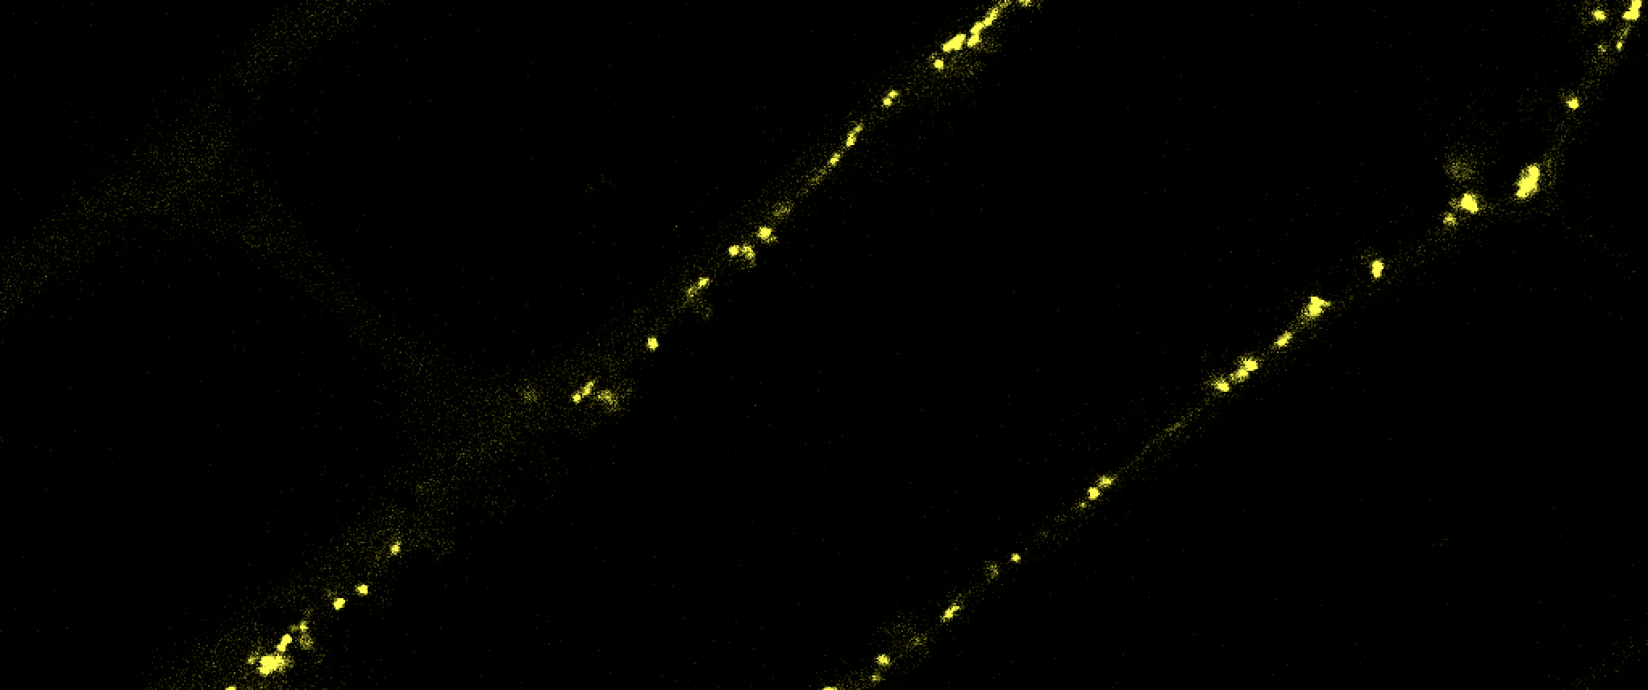
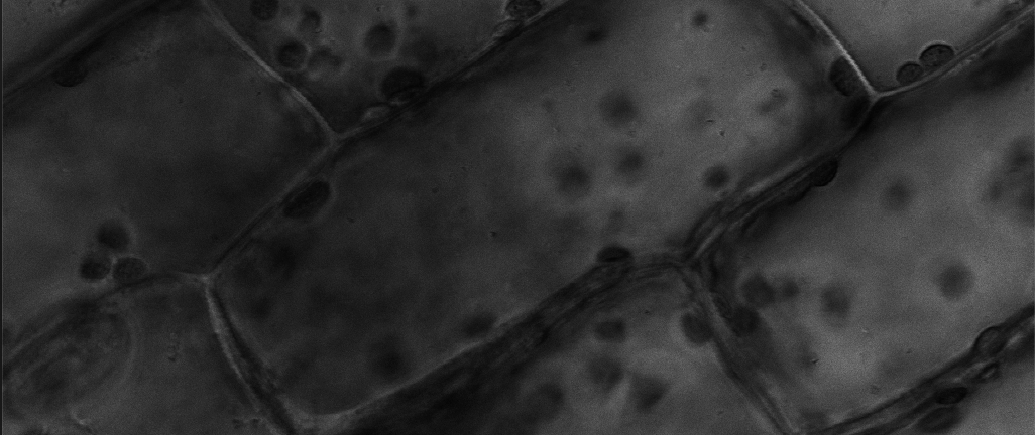




13.3”
Home
About
FAQs
Downloads
Sorghum Metabolic Atlas
7.5”
Enzyme Localization Database
Search proteins, genes by name, ID, RXNs, PWYs, gene family
Search
Advanced Search
or Browse Localization by Organelle
Organelle
# Enzymes Localized
Cytosol
12
Mitochondria
5
Chloroplast
7
Peroxisome
2
Nucleus
2
Vacuole
1
ER
4
Plasma-membrane
5
Click organelle to select
See candidates for selected organelles
Contact Us
Contribute Data
Cite Us
Our Funding
www.sorghummetabolicatlas.org
User Feedback
Notes:
Color to darker yellow? Make words black?
Pick a color from the logo? Try a few different shades?
User feedback --> survey form
Logos at the bottom can be smaller
Sorghum seeds for color palette
Alternatives for tables? Bar chart?
Updates:
Made logos smaller

Slide 2
13.3”
Home
About
FAQs
Downloads
Sorghum Metabolic Atlas
7.5”
Enzyme Localization Database
Search proteins, genes by name, ID, RXNs, PWYs, gene family
Search
Advanced Search
or Browse Localization by Organelle
Cytosol
Mitochondria
Chloroplast
Peroxisome
Nucleus
Vacuole
ER
5
10
Click organelle to select
See candidates for selected organelles
Contact Us
Contribute Data
Cite Us
Our Funding
www.sorghummetabolicatlas.org
User Feedback
Notes:
Color to darker yellow? Make words black?
Pick a color from the logo? Try a few different shades?
User feedback --> survey form
Logos at the bottom can be smaller
Sorghum seeds for color palette
Alternatives for tables? Bar chart?
Updates:
Made logos smaller
Bar graph instead of table
Color changes

Slide 3
13.3”
Home
About
FAQs
Downloads
Sorghum Metabolic Atlas
7.5”
Enzyme Localization Database
Search proteins, genes by name, ID, RXNs, PWYs, gene family
Search
Advanced Search
AND
OR
Subcellular Loc is [Plastid] AND Methods is [Egeria densa] AND Tags is [GFP, RFP]
To perform an advanced search:
Select queries from below and add to search
Add operators (above) for complex search
Search Sorghum bicolor proteins with …
Subcellular Loc
Methods
Tags
Gene Family
Nucleus
Golgi
Mitochondria
Peroxisome
Cytosol
Plasma-membrane
Vacuole
Plastid
ER
Contact Us
Contribute Data
Cite Us
Our Funding
www.sorghummetabolicatlas.org
User Feedback
Notes:
Look at common bio websites (advanced search): NCBI, Entrez, pubmed, webofscience, uniprot, amazon, orbits, expedia

Slide 4
13.3”
Home
About
FAQs
Downloads
Sorghum Metabolic Atlas
7.5”
Enzyme Localization Database
Search proteins, genes by name, ID, RXNs, PWYs, gene family
Search
Advanced Search
or Browse Localization by Organelle
Cytosol
Mitochondria
Chloroplast
Peroxisome
Nucleus
Vacuole
ER
5
10
Click organelle to select
See candidates for selected organelles
Contact Us
Contribute Data
Cite Us
Our Funding
www.sorghummetabolicatlas.org
User Feedback
Notes:
Color to darker yellow? Make words black?
Pick a color from the logo? Try a few different shades?
User feedback --> survey form
Logos at the bottom can be smaller
Sorghum seeds for color palette <- try some orangey-reds
Alternatives for tables? Bar chart?
Updates:
Made logos smaller
Bar graph instead of table

Slide 5
13.3”
Home
About
FAQs
Downloads
Sorghum Metabolic Atlas
7.5”
Enzyme Localization Database
Search proteins, genes by name, ID, RXNs, PWYs, gene family
Search
Advanced Search
or Browse Localization by Organelle
Cytosol
Mitochondria
Chloroplast
Peroxisome
Nucleus
Vacuole
ER
5
10
Click organelle to select
See candidates for selected organelles
Contact Us
Contribute Data
Cite Us
Our Funding
www.sorghummetabolicatlas.org
User Feedback
Notes:
Color to darker yellow? Make words black?
Pick a color from the logo? Try a few different shades?
User feedback --> survey form
Logos at the bottom can be smaller
Sorghum seeds for color palette
Alternatives for tables? Bar chart?
Updates:
Made logos smaller
Bar graph instead of table

Slide 6
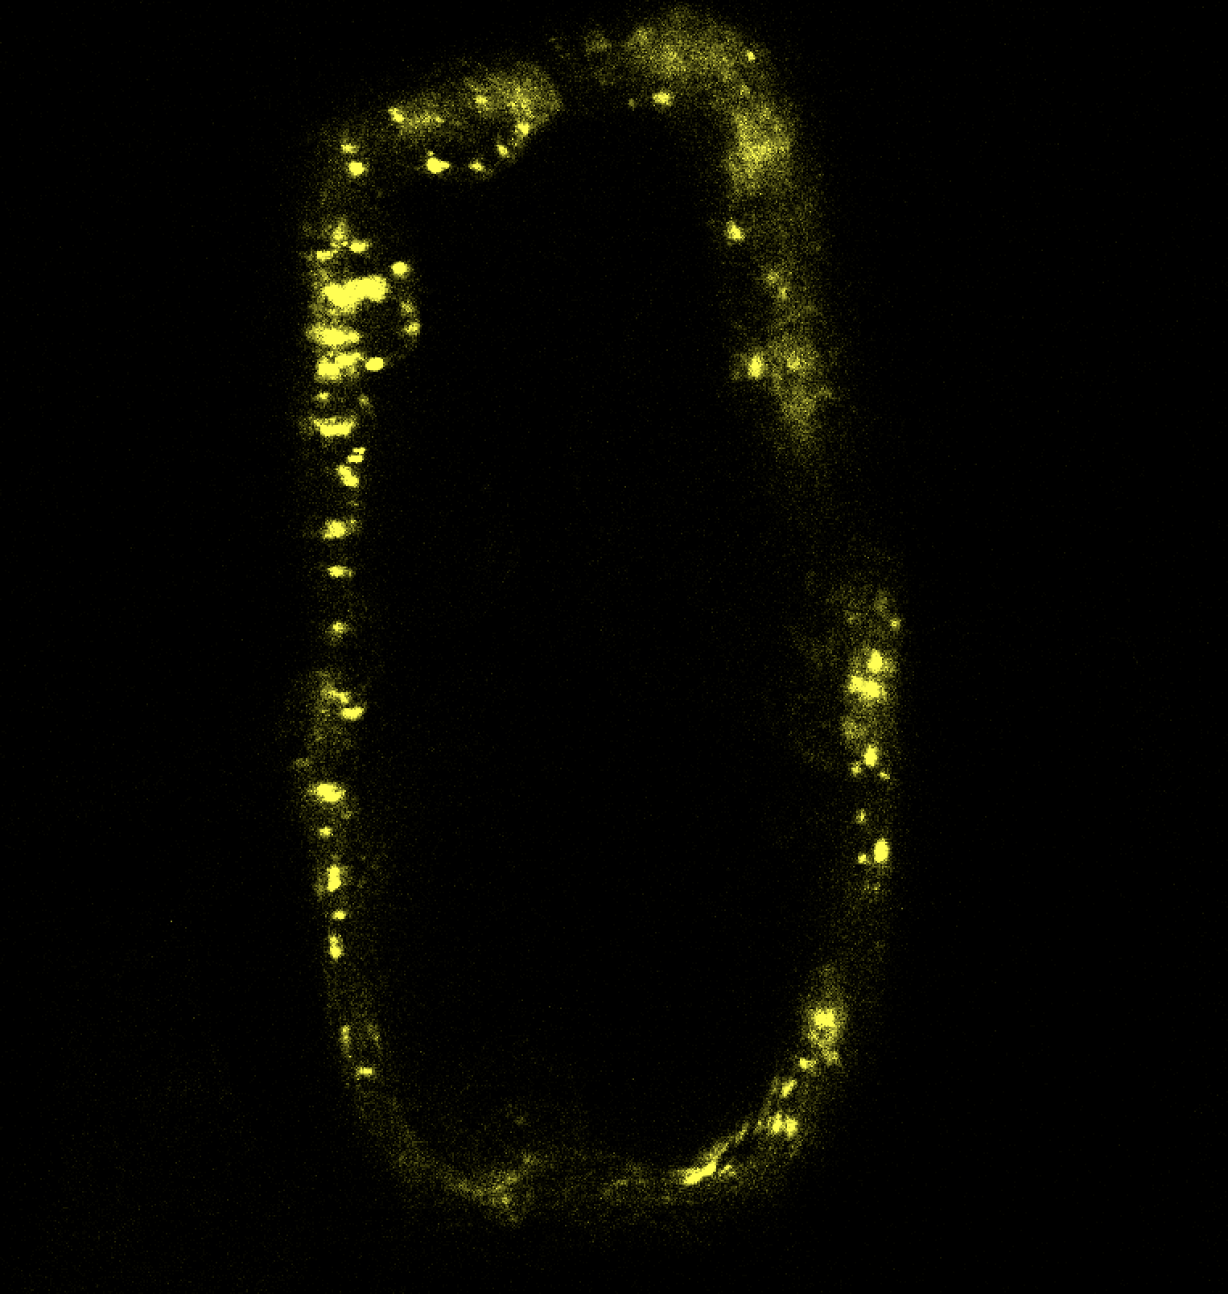
Home
About
FAQs
Downloads
Sorghum Metabolic Atlas
Enzyme Localization Database
Search proteins, genes by name, ID, RXNs, PWYs, gene family
Search
Advanced Search
Showing search results for Fatty acid receptor
5 results
All
Download selected
ID
Names
Loc
Image
Method
RXN
PWY
Gene family
FAR1
Fatty acid receptor 1
nucleus
E. densa
FAR2
Fatty acid receptor 2
ER
E. densa
FAR3
Fatty acid receptor 3
nucleus
E. densa
FAR4
Fatty acid receptor 4
ER
E. densa
FAR5
Fatty acid receptor 5
ER
E. densa
Contact Us
Contribute Data
Cite Us
Our Funding
www.sorghummetabolicatlas.org
User Feedback

Slide 7
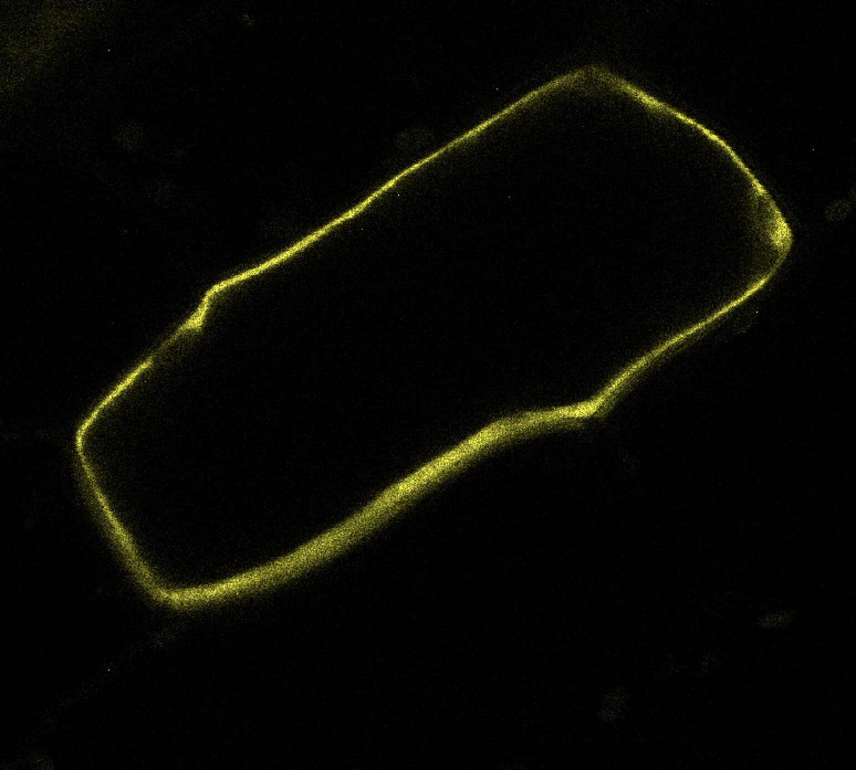
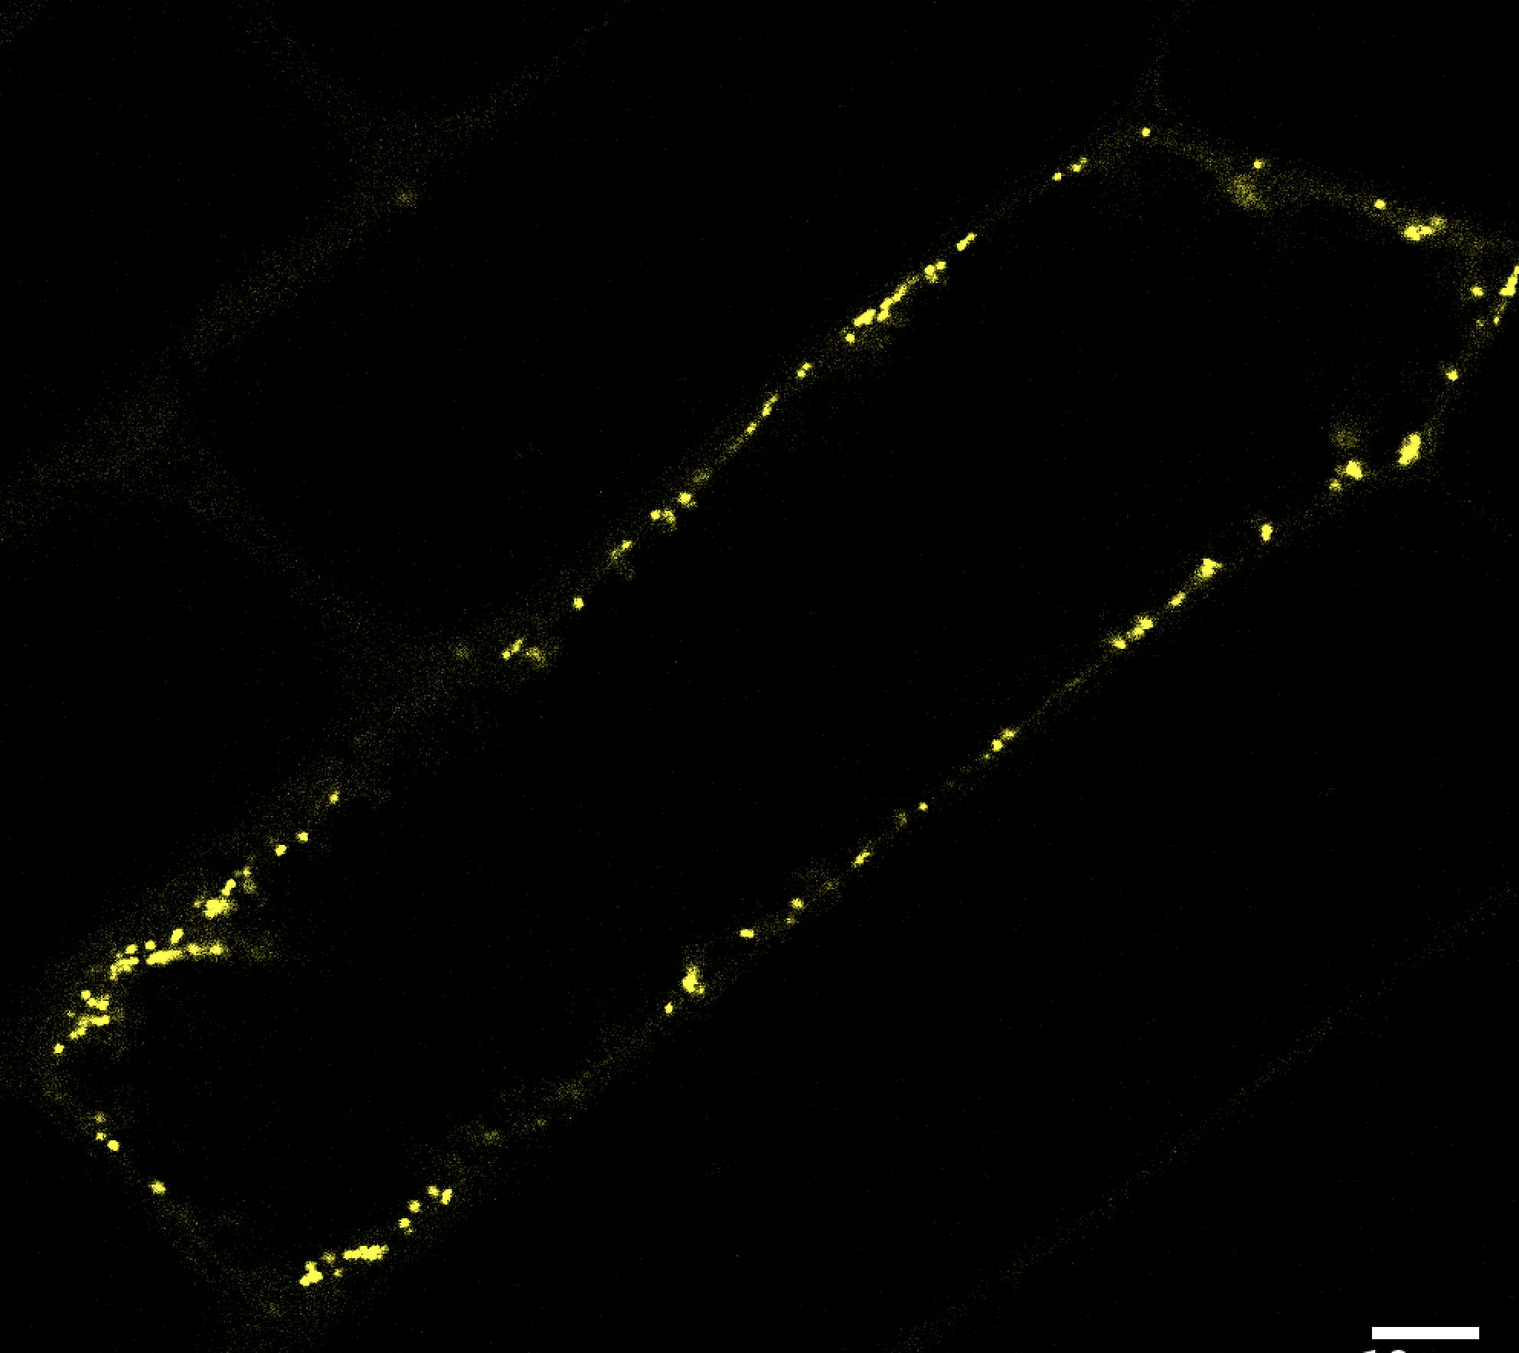
Home
About
FAQs
Downloads
Sorghum Metabolic Atlas
Enzyme Localization Database
Search proteins, genes by name, ID, RXNs, PWYs, gene family
Search
Advanced Search
Showing search results for Fatty acid receptor
Select All
4 results
See results in table format
Filter by:
Fatty acid receptor 1
ID: FAR
Other names:
Localization:
Method:
RXN:
PWY:
Gene family:
Method
E. densa
N. benthamiana
Tag
Fatty acid receptor 2
GFP
ID: FAR
Other names:
Localization:
Method:
RXN:
PWY:
Gene family:
mCherry
citrine
Fatty acid receptor 3
ID: FAR
Other names:
Localization:
Method:
RXN:
PWY:
Gene family:
Contact Us
Contribute Data
Cite Us
Our Funding
www.sorghummetabolicatlas.org
User Feedback
Notes:
Updates:
- Added download boxes
- Added option for table format

Slide 8
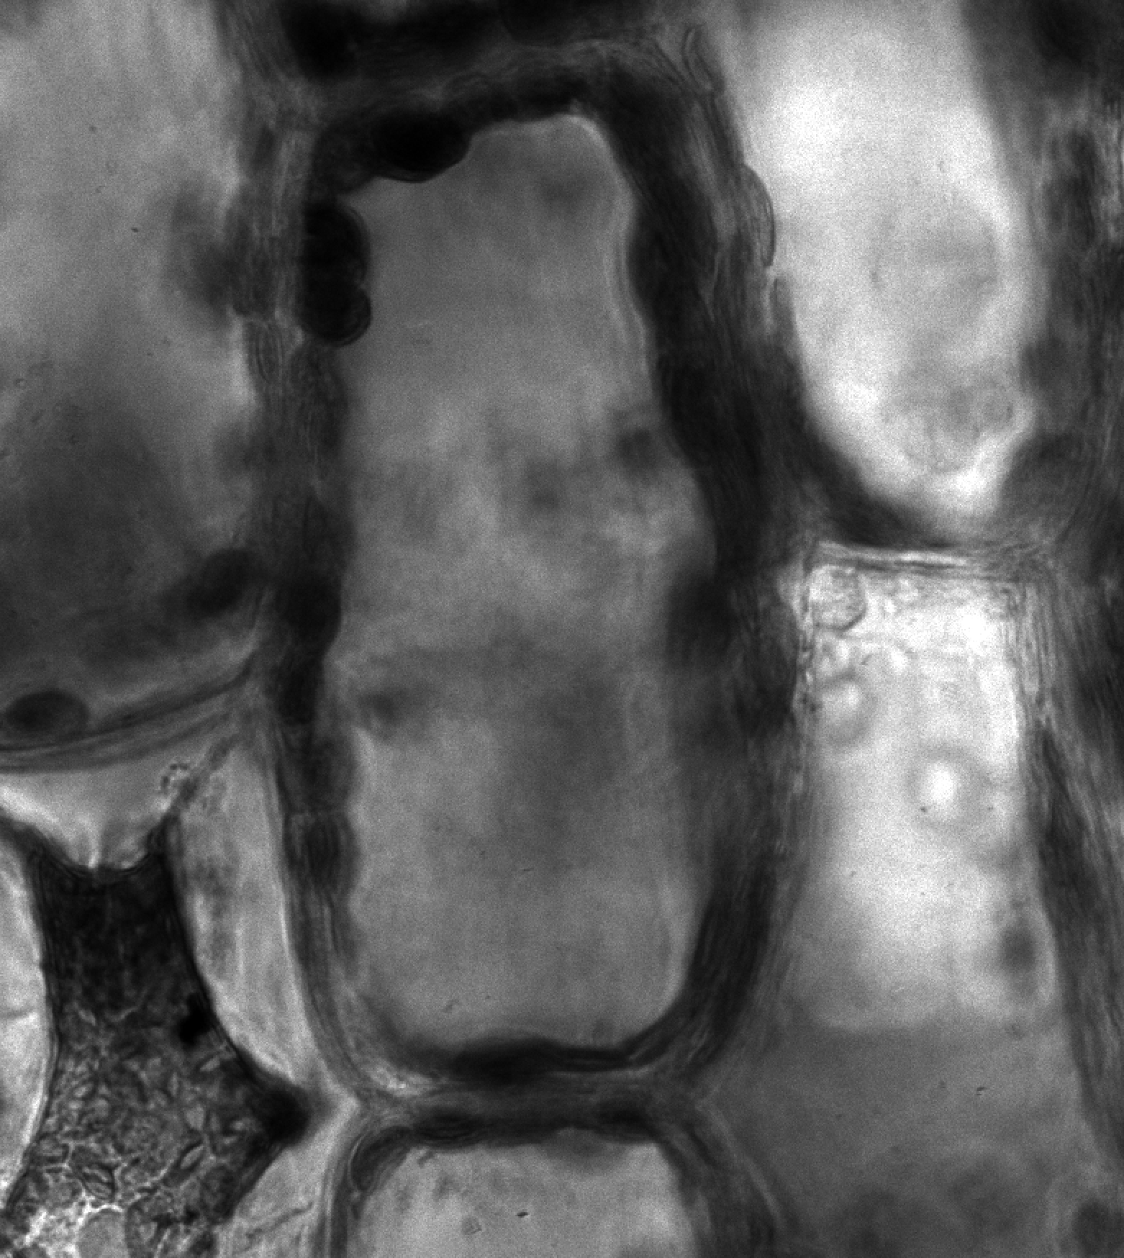
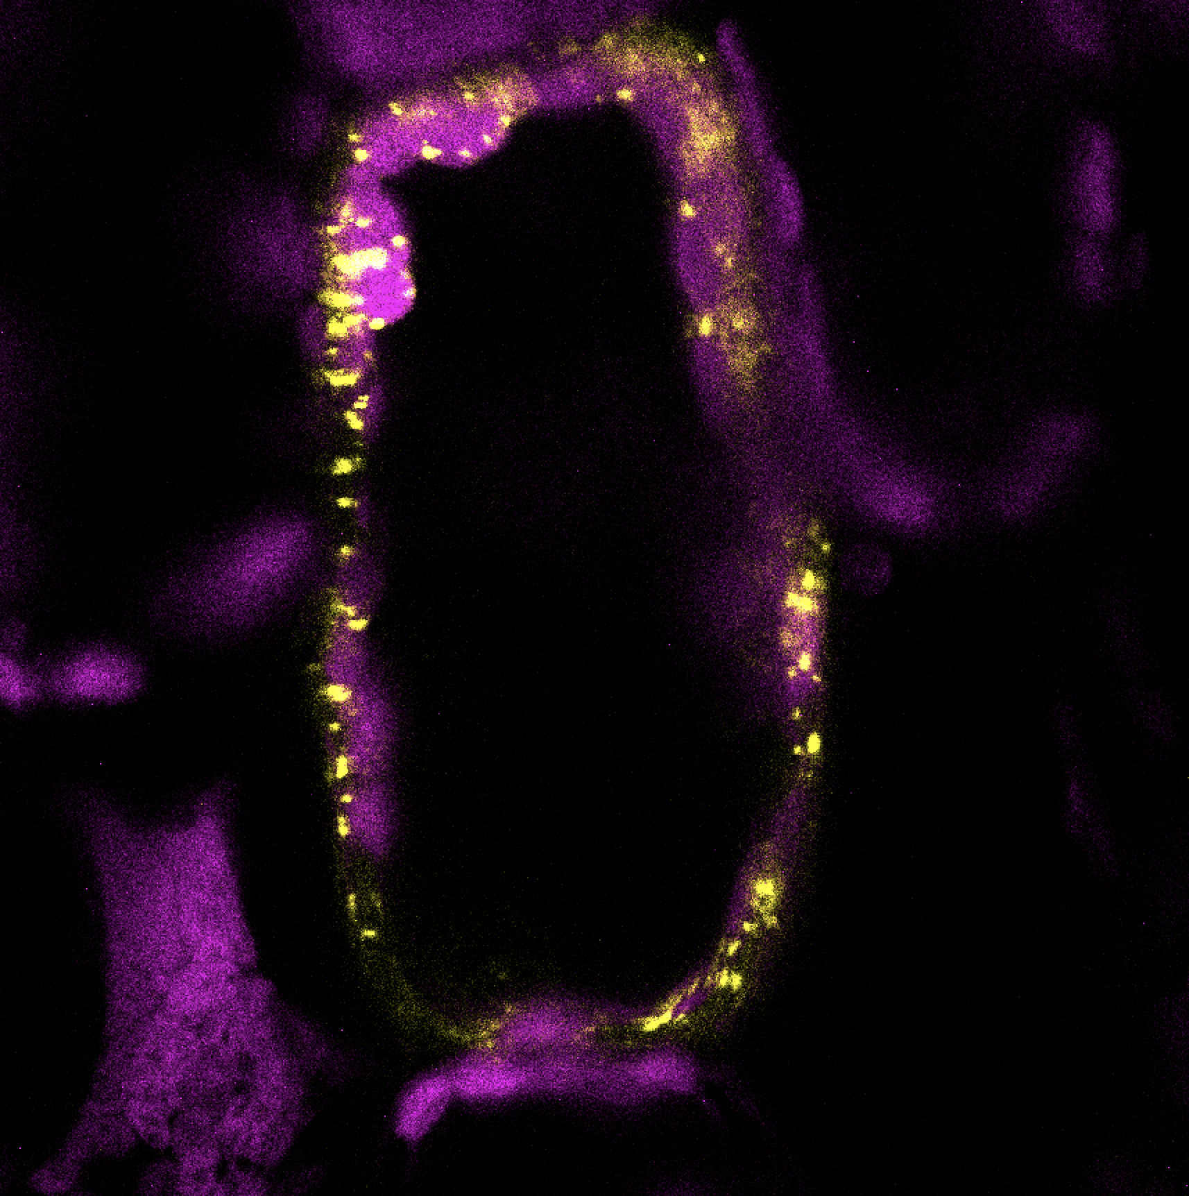
Home
About
FAQs
Downloads
Sorghum Metabolic Atlas
Enzyme Localization Database
Search proteins, genes by name, ID, RXNs, PWYs, gene family
Search
Advanced Search
Fatty acid receptor 1
Display
Sobic.000G0000
Localization
fatty acid receptor 1, FAR1
Co-Localization
Summary: receptor protein binding long and medium-chain fatty acid molecules
Orthologs
EC: 0.0.0.0
References
RXN: RXN-000
PWY: PWY-000
Domain: fatty acid metabolism
Localization
Localization: cytosol
Method: biolistic
Host: Egeria densa
Tag: YFP
Vector: modified pANIC5A vector
Co-Localization
Localization: cytosol
Method: biolistic
Marker: cytosolic
Orthologs
Gene Family
Ortholog
Species
Loc
Method
PubMed ID
FAR
Sobic.00G001
S. bicolor
cytosol
agro
000000
FAR
AT0G00001
A. thaliana
nucleus
biolistics
000000
Contact Us
Contribute Data
Cite Us
Our Funding
www.sorghummetabolicatlas.org
User Feedback
Notes:
Updates:
Better headers to delineate modules
Clickable menu at top
Remove sorghum metabolic atlas or make smaller? Try minimizing the header

